Slide 1

HWA project
By Ashley Cameron

Slide 2

Approach
Made sprints in JIRA
Planned database layout and created ERD
Focus on JAVA aspect

Slide 3
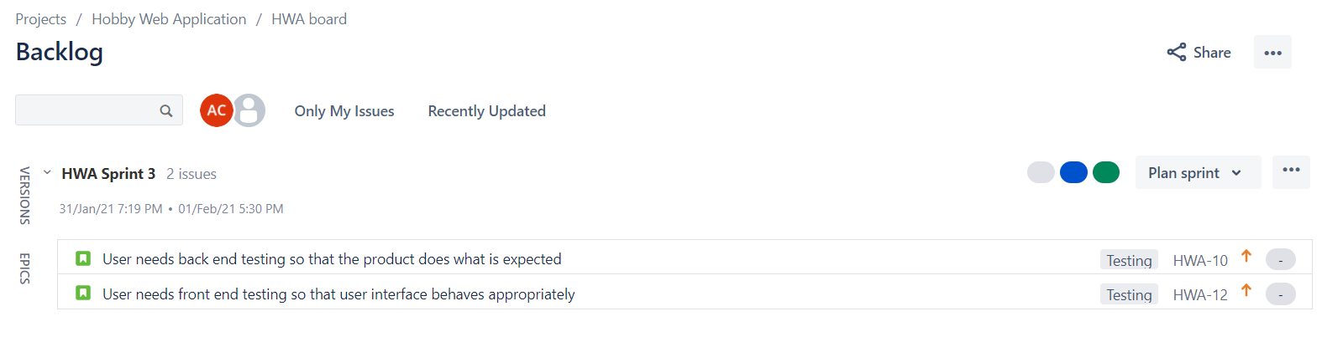
JIRA

Slide 4
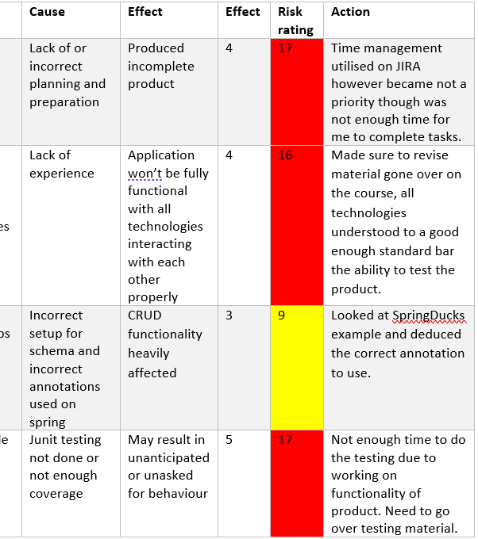
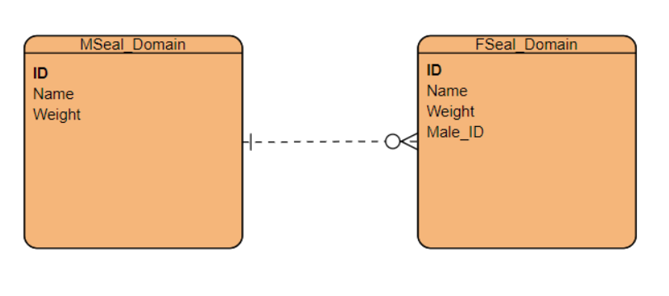
Design phase

Slide 5
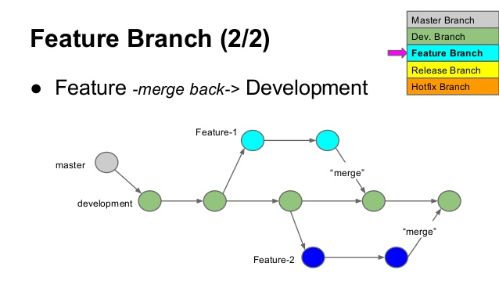
Version control
Developer feature branch model
Took one feature at a time
Was effective as a strategy

Slide 6
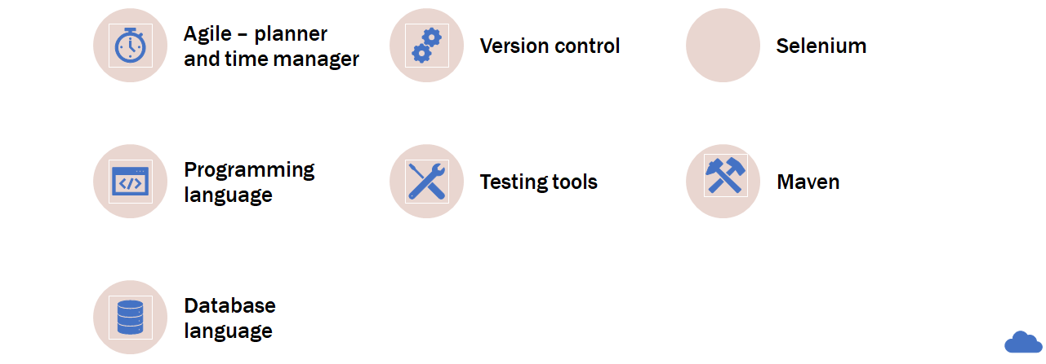

Consultant journey
Consultant journey

Slide 7
Testing coverage
Hopefully this info isn't that depressing this time!

Slide 8

Demo

Slide 9
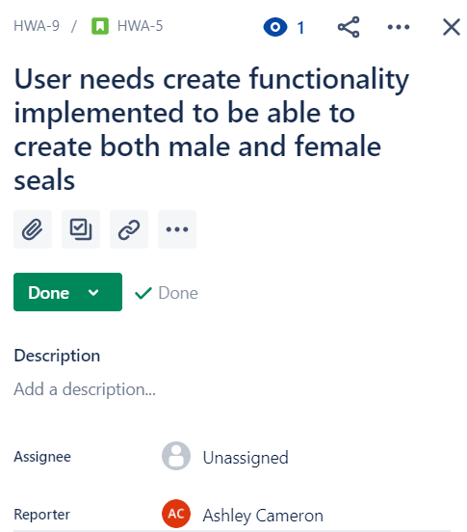
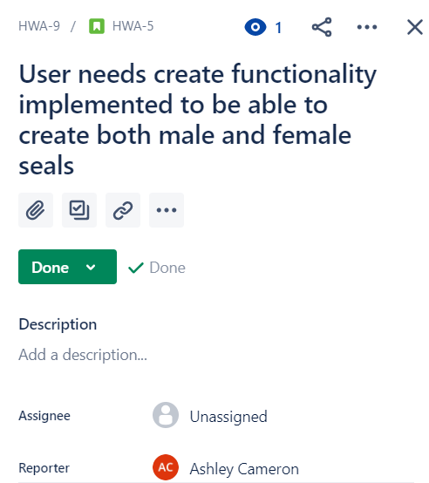
User stories
Need to be clear and succinct
Should omit no information
Customer focused and deliverable

Slide 10
Sprint review
Was completed
Back-end CRUD
Front-end CRUD
Web design
Wasn’t completed
Test coverage
Selenium
Usual testing

Slide 11
Looking back
Sprints calculated reasonably well
More time needed for testing sprints
More detailed and specific user stories

Slide 12

conclusion
Working product though not tested well enough
Website could be more appealing
With more time could have been a good product

Slide 13

Thank you for listening
Any questions?

